Slide 1
Consumer Lending
Pre-screening & Onboarding Agent

Slide 2




Consumer Lending
Pre-screening & Onboarding Agent
Agent-1 : Collects the customer details Like Name and Mobile number
Agent-2 : Collects the interested products
Like Home Loan/Personal Loan/Education Loan/Gold loan
Agent-3 : Loan Documents Agent
provide the information on loan processing checklist Aadhaar Card / PAN Card
Agent-4 : Customer Proxy Agent
This is not a LLM agent. It just takes the input from the user

Slide 3
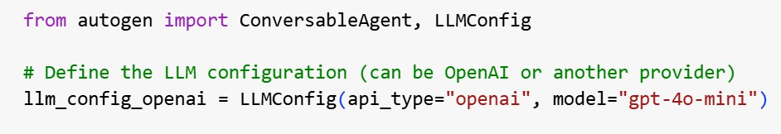
Initial Setup

Slide 4
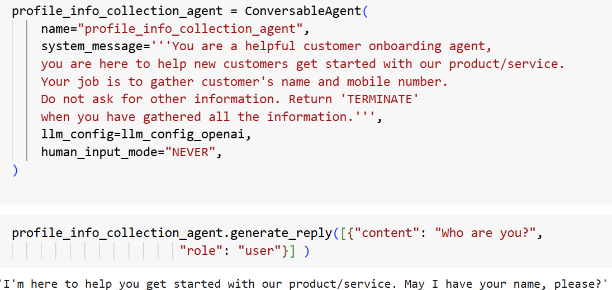
Agent-1 : Collects the customer details

Slide 5
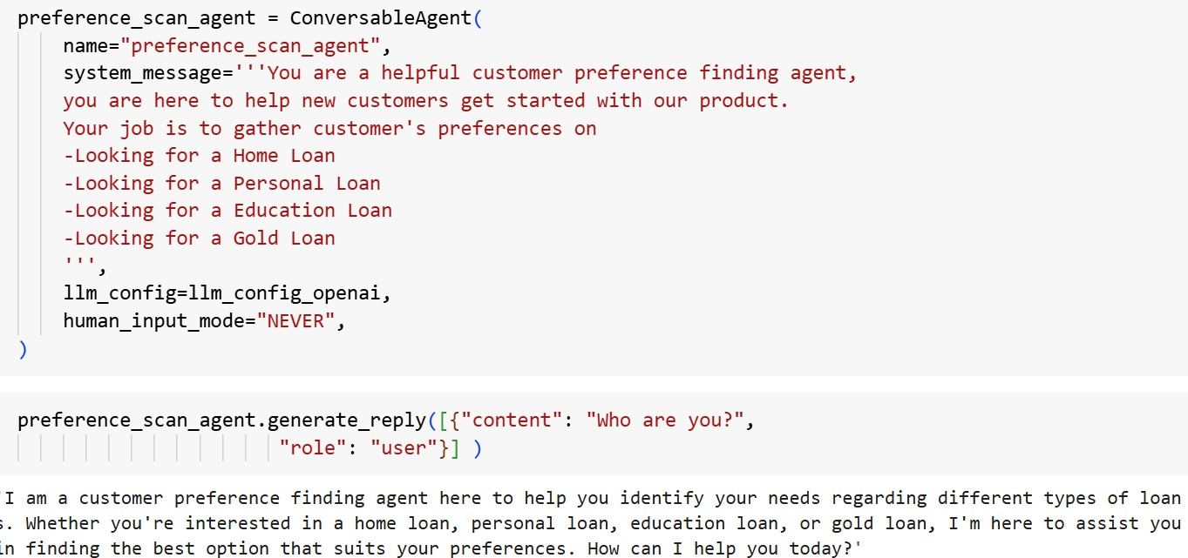
Agent-2 : Collects the interested products

Slide 6
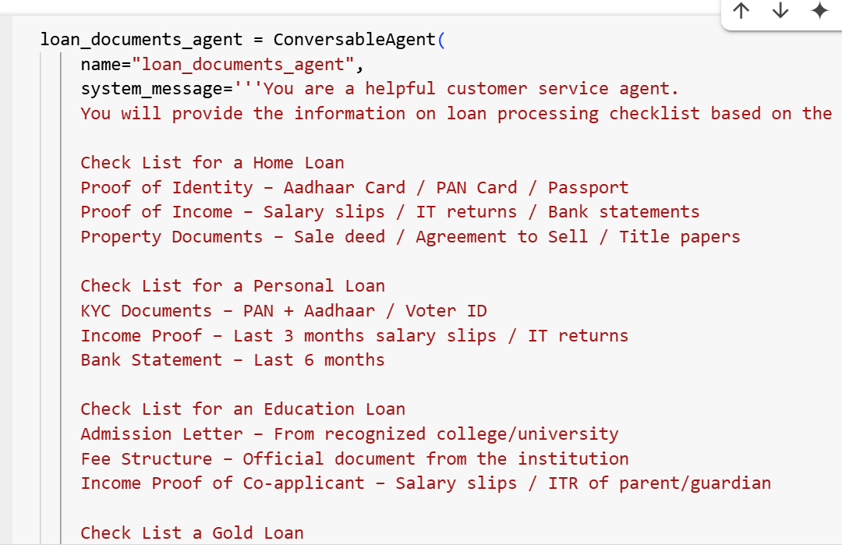
Agent-3: Loan Documents Agent

Slide 7
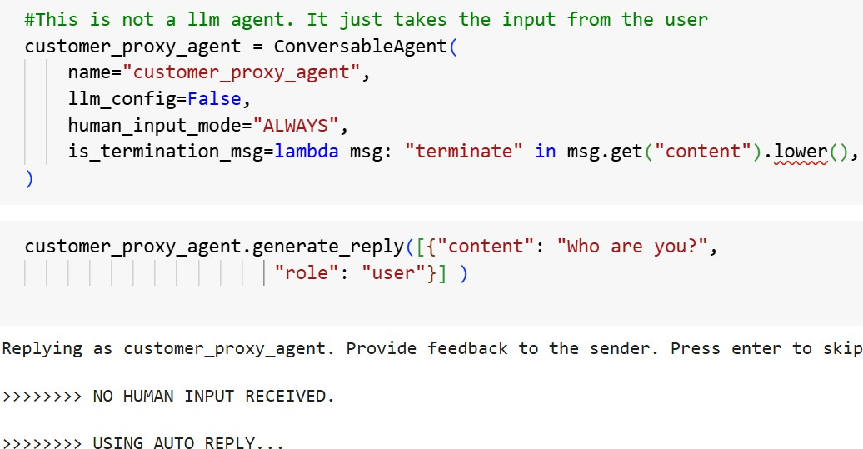
Agent4: Customer Proxy Agent

Slide 8
Creating Tasks
Agent-1 : Collects the customer details
Gets the name and Mobile number
Agent-4 : Customer
Proxy Agent
Agent-2 : Collects the interested products
Gets the information on type of loan
Agent-4 : Customer
Proxy Agent
Agent-4 : Customer Proxy Agent
Provides the information on documents
Agent-3 : Loan Documents Agent

Slide 9
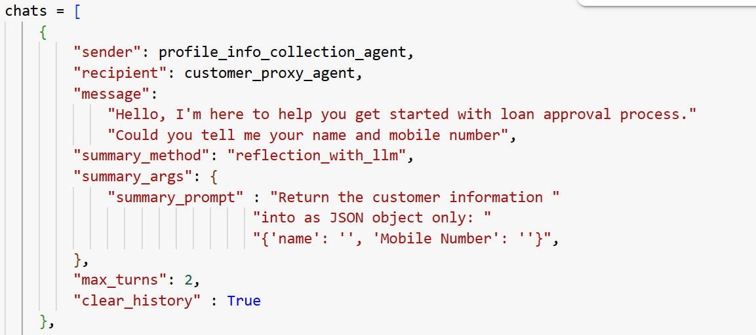
Creating Tasks

Slide 10
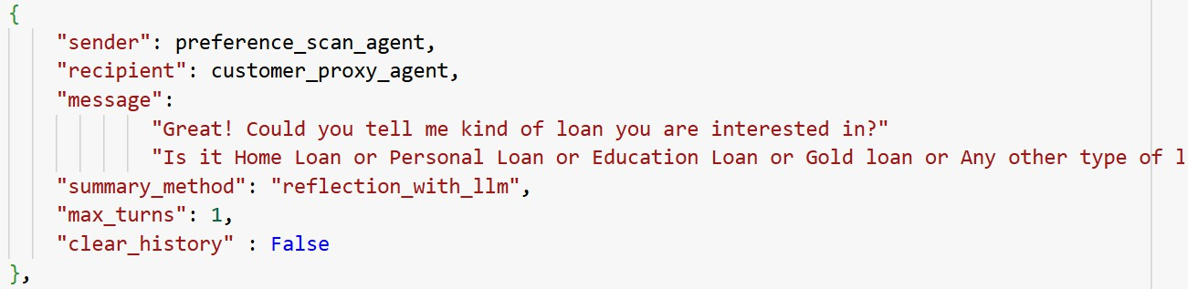
Creating Tasks

Slide 11
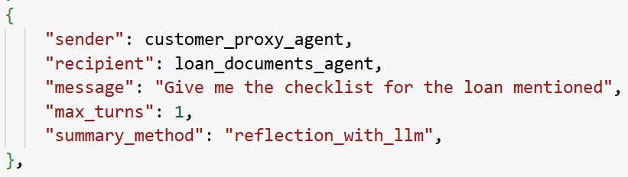
Creating Tasks

Slide 12
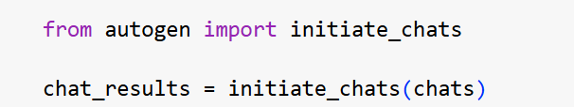
Initiate chats

Slide 13
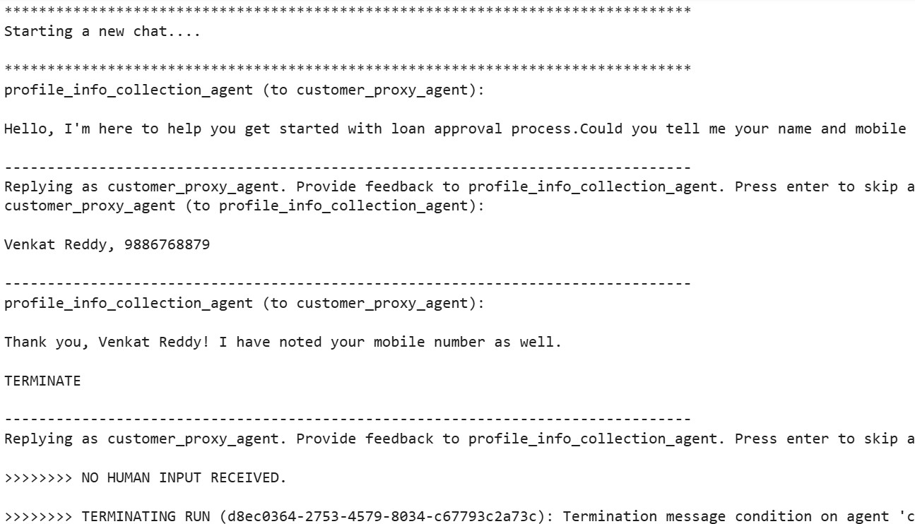
Chat Results
Pratikpra

Slide 14
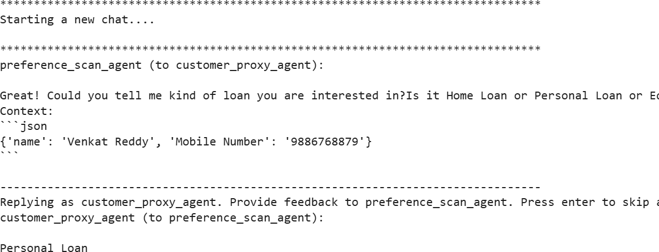
Chat Results

Slide 15
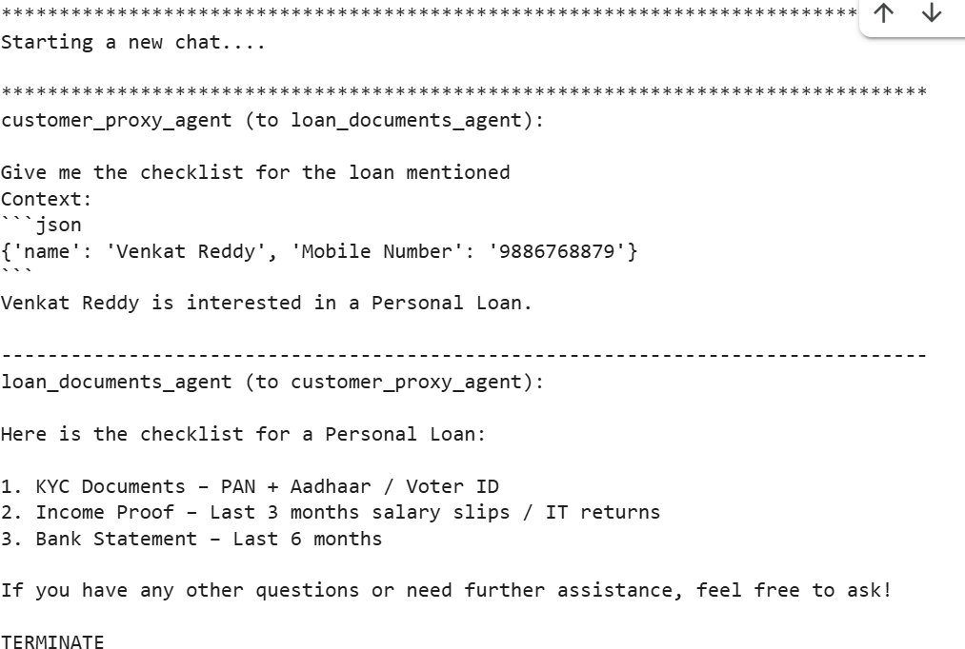
Chat Results

